Slide 1
E-Resources in Academic Libraries:
Opportunities, Challenges, and Future
Agus Rifai, PhD

Slide 2
Description
The slides present the concepts and platform of electronic resources, and explore its opportunities, challenges and future in academic libraries

Slide 3
Agenda
01
Introduction:
Library, Resources, & Education
02
E-Resources: Concepts & platforms
03
E-Resources: the future, Opportunities, and Challenges for Academic Libraries

Slide 4
Introduction
"A university is just a group of buildings gathered around a library.” ​
– Shelby Foote.
Technology has changed the face of libraries and is continuing to change how we work and how we deliver services to our library customers. The ability to identify and incorporate appropriate emerging technology trends into a library setting is paramount to continually providing excellent services ​
David Lee King (2018)

Slide 5
Introduction
Education
(learning & Research)
Three indissoluble and indivisible concepts of Higher Education Scenario.
Patra (2017). Digital Disruption and Electronic Resource Management in Libraries
Resources
Library
A gateway to Information
one-stop solution
Higher Education System is moved toward ICT based teaching and learning and library is a part of learning system and supporting system to teaching area.
An academic library has to function as a central gateway for library users to access, locate, transform, and utilize information resources in a variety of printed and electronic formats via applications, databases, networks, platforms and systems.
Annapure S. G (2019)
Kumar (2009). Academic Libraries in Electronic Environment: Paradigm Shift

Slide 6
A Paradigm Shift in Academic Libraries
High dependence on e-resources and digital resources
Traditional academic libraries
21st Century academic libraries
services are available 24/7
e-journal and open access journals
To buy e-resources including hardware and software resources
A Shift From Printed to electronic resources
Jain (2013)
Academic libraries have altered the perceptions (and their patrons’ perceptions) from being an institution of books and printed materials to being an institution that provides pathways to high-quality information.

Slide 7
New dimension of academic libraries & Libraries of yesterday were practically all about collections, today’s libraries have been transformed from information storage places to learning gateways.
ICT is a key challenge and transform the library and the perception of the traditional library and librarian. E-books, e-Textbooks; digital resources, libraries are overwhelmed by electronic resources.
The diffusion of the Internet into libraries’ work flow & Digital /virtual library; hybrid libraries § User centered approach; change of user information behavior

Slide 8
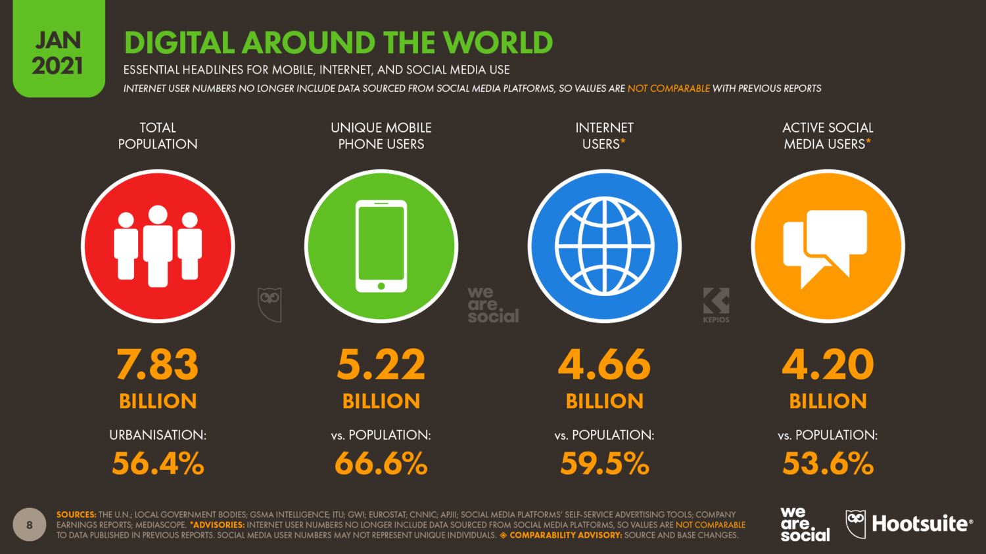
Text Here
25%
Text Here
15%
Text Here
35%
Text Here
10%
Text Here
15%
Change of user information behavior
Finding information is the main reason why people go online, with almost two-thirds of the world’s internet users saying this is one of their top motivations.

Slide 9
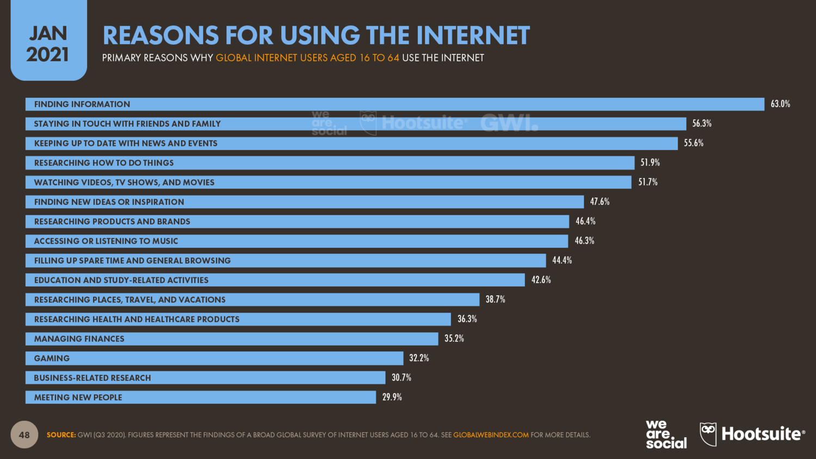
Text Here
25%
Text Here
15%
Text Here
35%
Text Here
10%
Text Here
15%
Content Here
Finding information is the main reason why people go online, with almost two-thirds of the world’s internet users saying this is one of their top motivations.

Slide 10
Electronic Resources
(E-Resources)
Shift Paradigm of Academic Libraries

Slide 11
Electronic Resources
(E-Resources)
…..refer to those materials require computer access, whether personal computer, mainframe, or handheld mobile device.
….they may either be accessed remotely via the internet or locally.
online information resources
Johnson, Sharon (2012)
An electronic resource is defined as a resource which require computer access or any electronic product that delivers a collection of data, be it text referring to full text bases, electronic journals, image collections, other multimedia products and numerical, graphical or time based, as a commercially available title that has been published with an aim to being marketed..
M. Suresh (2020)

Slide 12
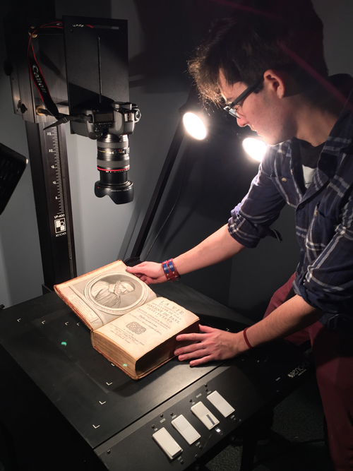
Electronic Resources (E-Resources)
They include both “born digital” material which has been produced directly online, for example-e- journals, databases, and print resources which have been scanned and digitized.

Slide 13
Different types of e-resources
electronic resources include: articles, online journals, e-books, e-theses, databases, web sites, portals, gateways, blogs, etc.

Slide 14
Access to Electronic Resources (E-Resources)
Electronic resources are accessible in libraries as (1) licensed (paid) services and (2) open (free) e-resources, or open access resources.

Slide 15
Publisher of Electronic Resources (E-Resources)
Electronic resources are published by (1) Commercial Publisher and (2) Learned Societies Publisher, and University Presses or publisher.

Slide 16
Commercial publisher
Elsevier, Wolter Kluwer, John Wiley, Blackwell, Sage, Taylor & Francis, World Scientific, Hindawi Publishing

Slide 17
Commercial publisher
Commercial Publisher
Platform
Articles
(estimasi)
9.000.000
6.855.549
4.200.000
Elsevier Springer Taylor &
Francis
Wiley
Sage Emerald
elsevier.com springer.com taylorandfrancis.com
sciencedirect.com link.springer.com tandfonline.com
wiley.com sagepub.com
emeraldgrouppublishing.co m
brill.com
onlinelibrary.wiley.com journals.sagepub.com emeraldinsight.com
4.000.000
3.000.000
333.000
Brill
brill.com/search
200.000
Harliansyah (2021)

Slide 18
Publisher​ | ​ | Platform​ | Journal​
Cambridge University Press​ | cambridge.org​ | cambridge.org/core​ | 437​
Oxford University Press​ | oup.com​ | academic.oup.com​ | 324​
Harliansyah (2021)

Slide 19
Learned Society publisher
Publisher
Platform
Journal
American Chemical Society American Physical Society
American Psychological Association (APA) American Society of Mechanical Engineers
acs.org aps.org apa.org asme.org
pubs.acs.org aps.org/publications psycnet.apa.org asmedigitalcollection.asme.
org
ieeexplore.ieee.org
50
50
90
35
Institute of Electrical and Electronics Engineers (IEEE)
American Society of Civil Engineers (ASCE)
ieee.org
217
asce.org
ascelibrary.org
38
Association for Computing Machinery (ACM)
acm.org
dl.acm.org
50
Harliansyah (2021)

Slide 20
Access to e-Resources
Username & password
IP Address
URLs and local proxy server

Slide 21
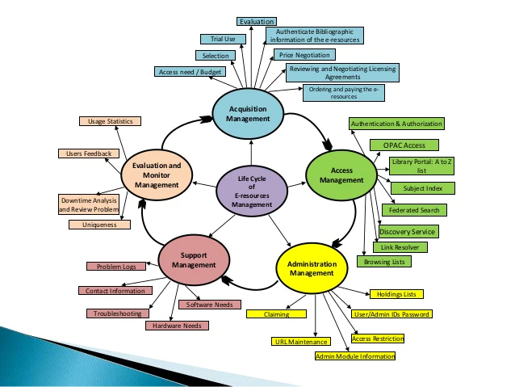
Roles of Electronic Resources Librarians (ERL)
Electronic resources require librarians to take on new roles, tasks, and responsibilities.
Patra (2019)

Slide 22
Open Access E-Resources:
Trend, Opportunities, & Challenges
"To ask why we need libraries at all, when there is so much information available elsewhere, is about as sensible as asking if roadmaps are necessary now that there are so very many roads."
Jon Bing (2014)

Slide 23
Open Access Resources
Open Access refers to resources that are freely available for viewing and/or use
Open Access is not related to the quality of materials or the peer-review/non-peer-review status of the publications
Open Access differs from Open Source or Open Licensed in that the primary use of Open Access materials will be viewing or reading, while Open Source materials are available for modification of the underlying software or text.
https://libguides.southernct.edu/openaccess

Slide 24
Open Access: the Opportunities
Open access to the scholarly literature is a public good that will “accelerate research, enrich education, share the learning of the rich with the poor and the poor with the rich, make this literature as useful as it can be, and lay the foundation for uniting humanity in a common intellectual conversation and quest for knowledge” (Budapest Open Access Initiative, 2002).
https://sustainingknowledgecommons.org/about/

Slide 25
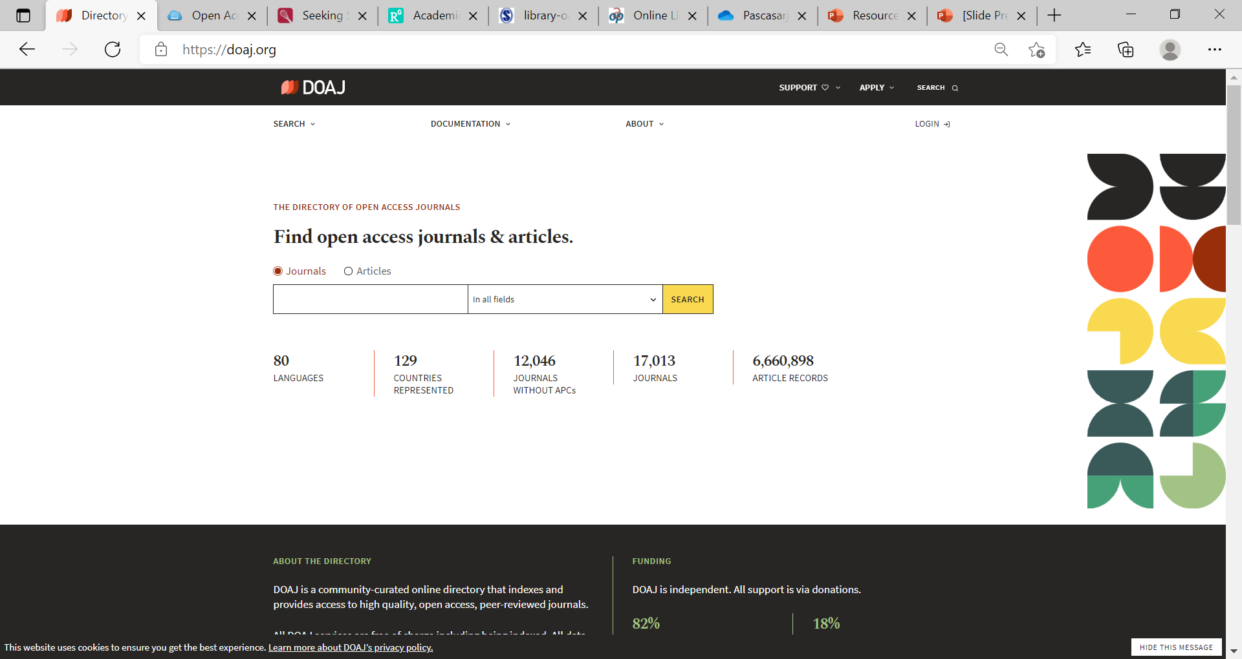
Open Access Journal Database

Slide 26
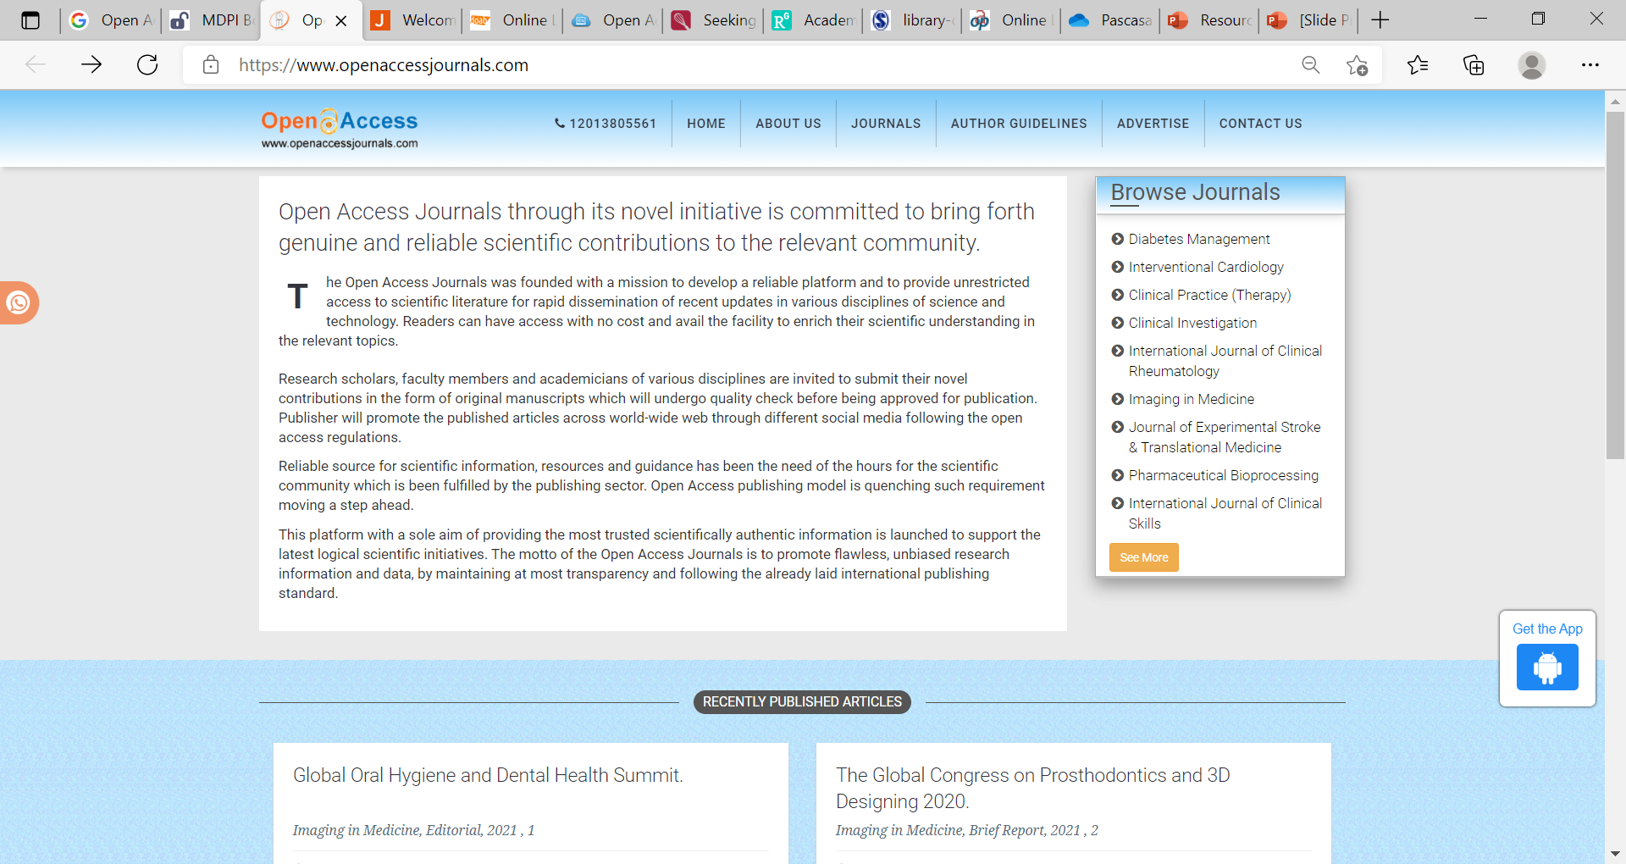
Open Access Journals

Slide 27
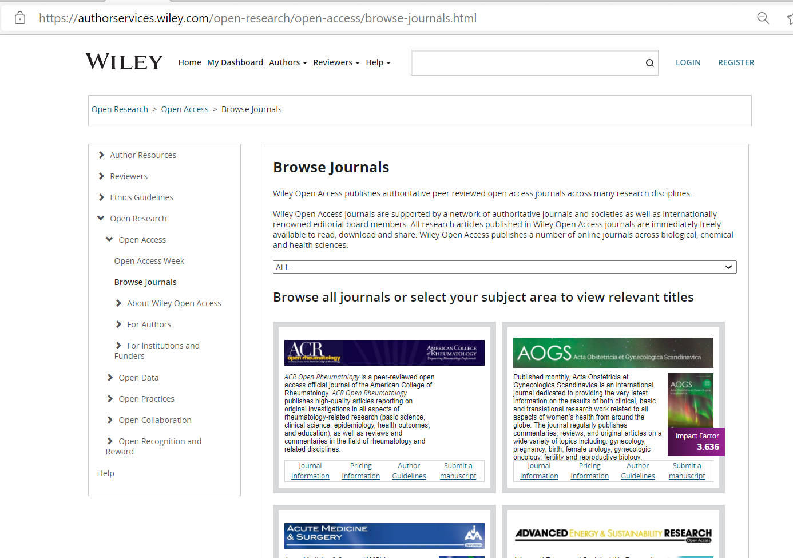
Open Access Journals from commercial publisher

Slide 28
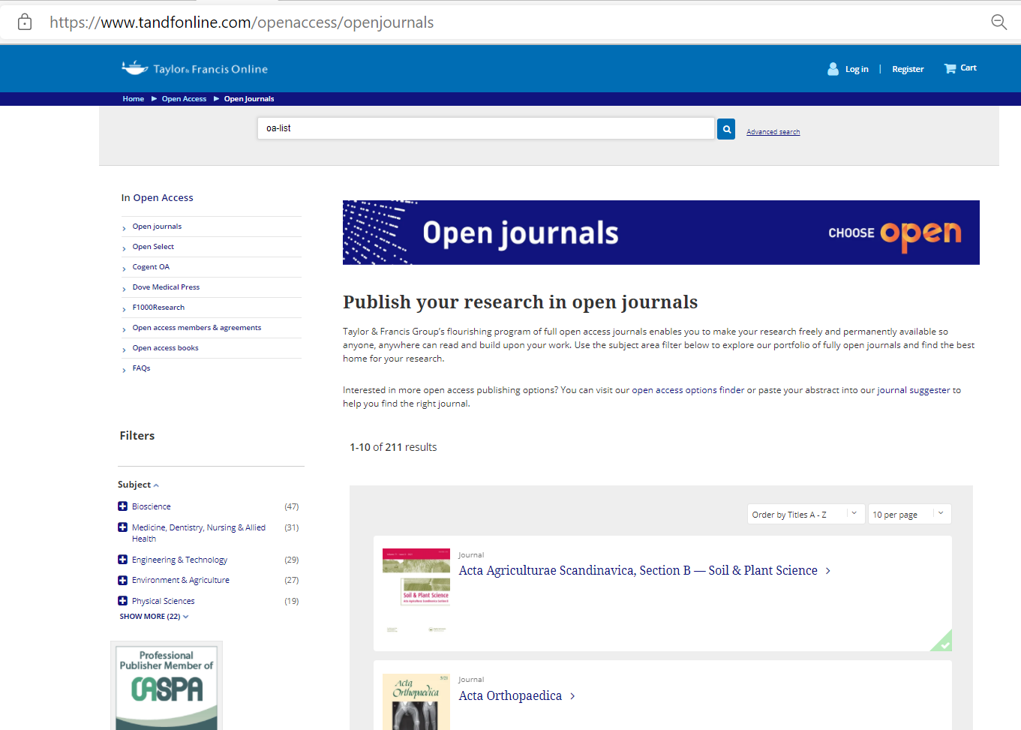
Open Access Journals from commercial publisher

Slide 29
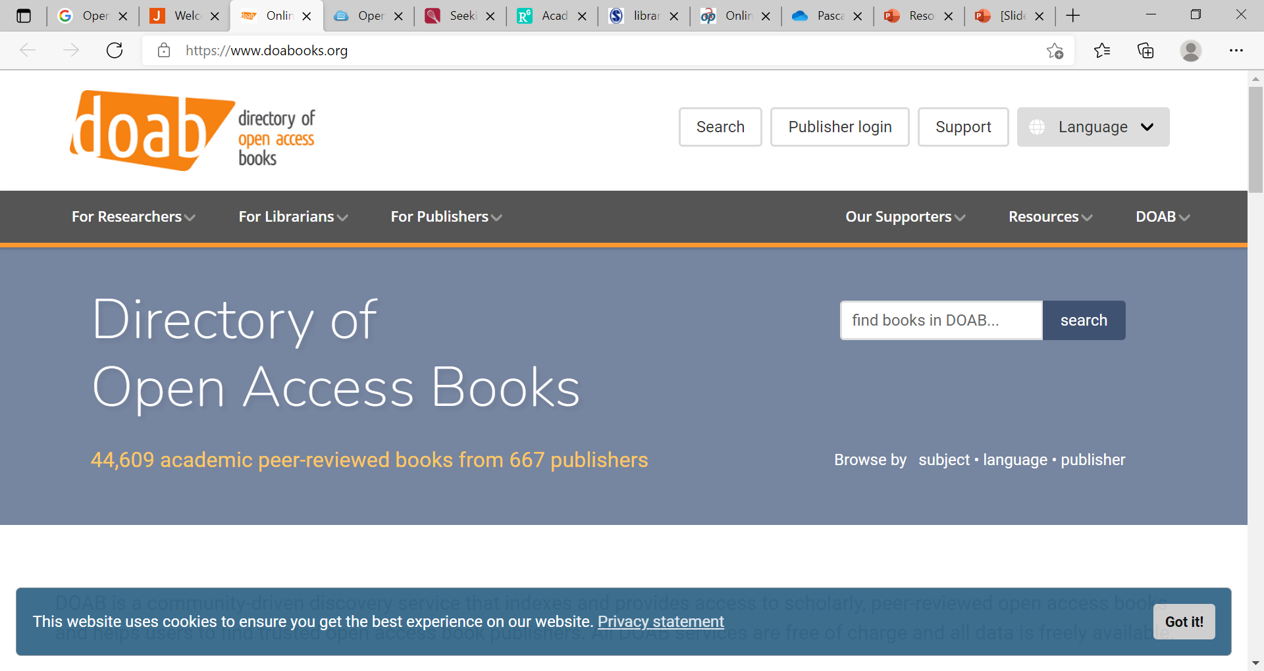
Open Access Books

Slide 30
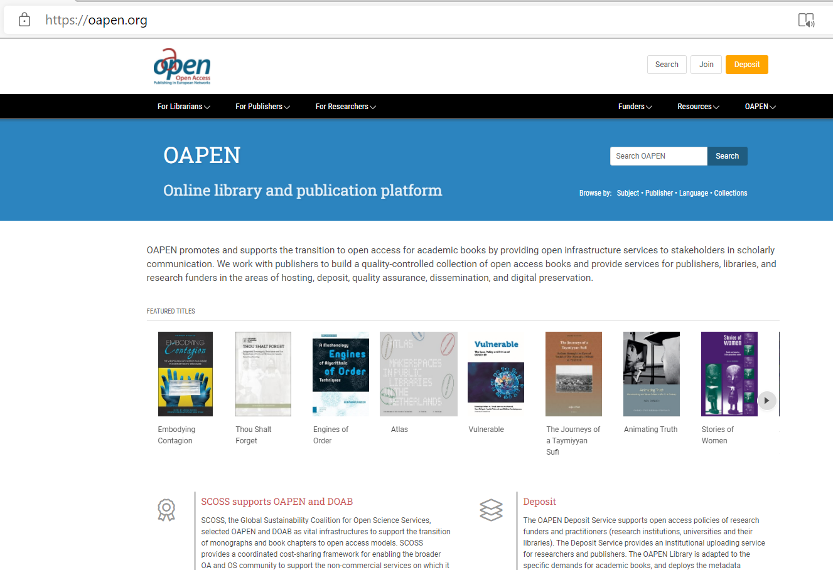

Slide 31
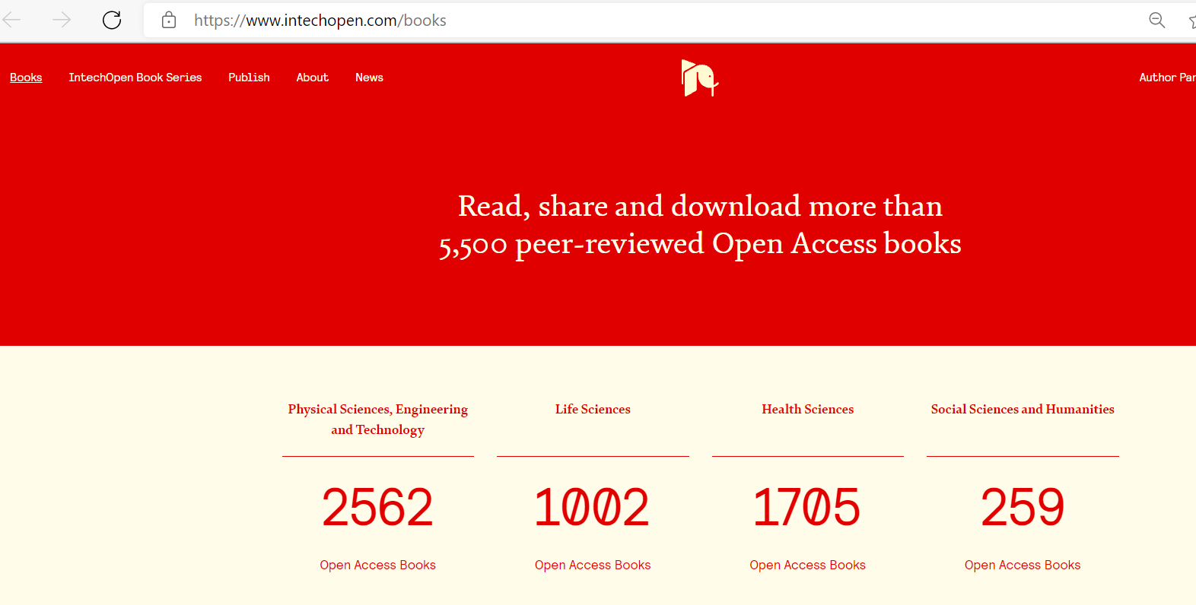

Slide 32
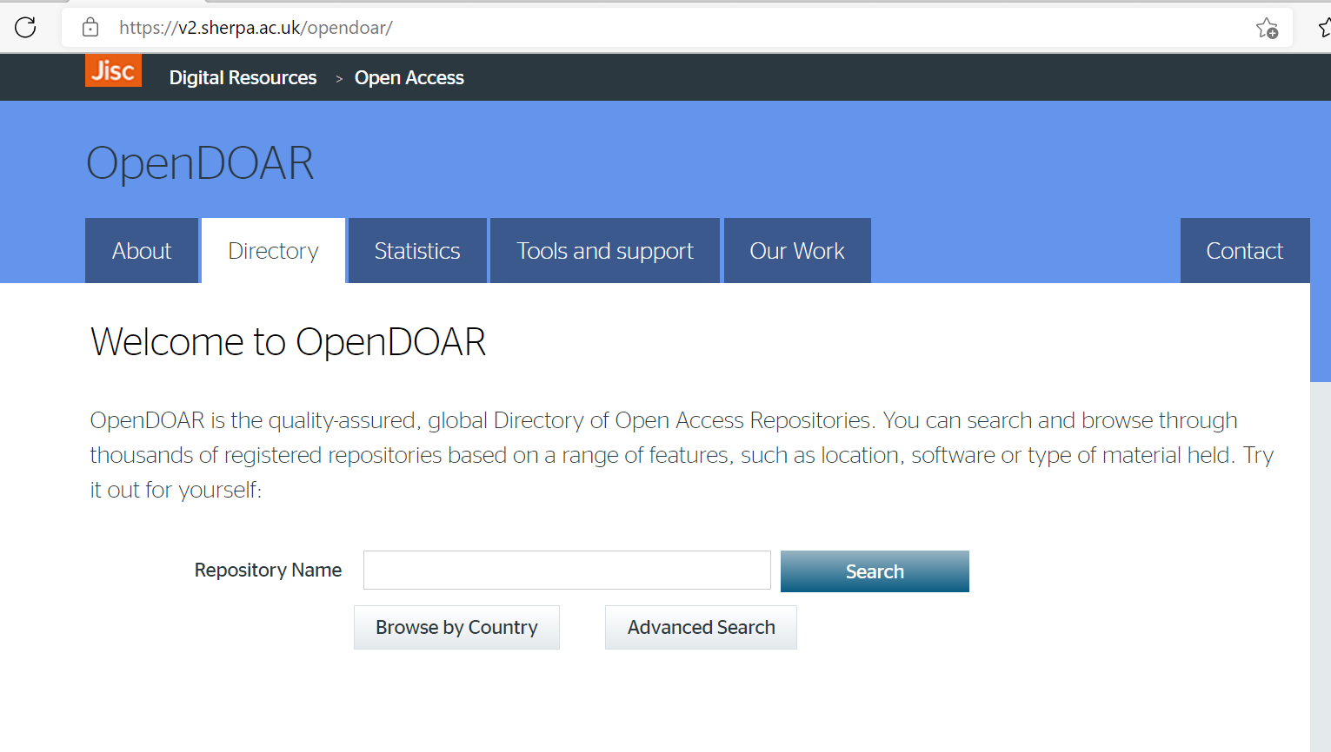
https://v2.sherpa.ac.uk/opendoar/
Open Access Repositories Database

Slide 33
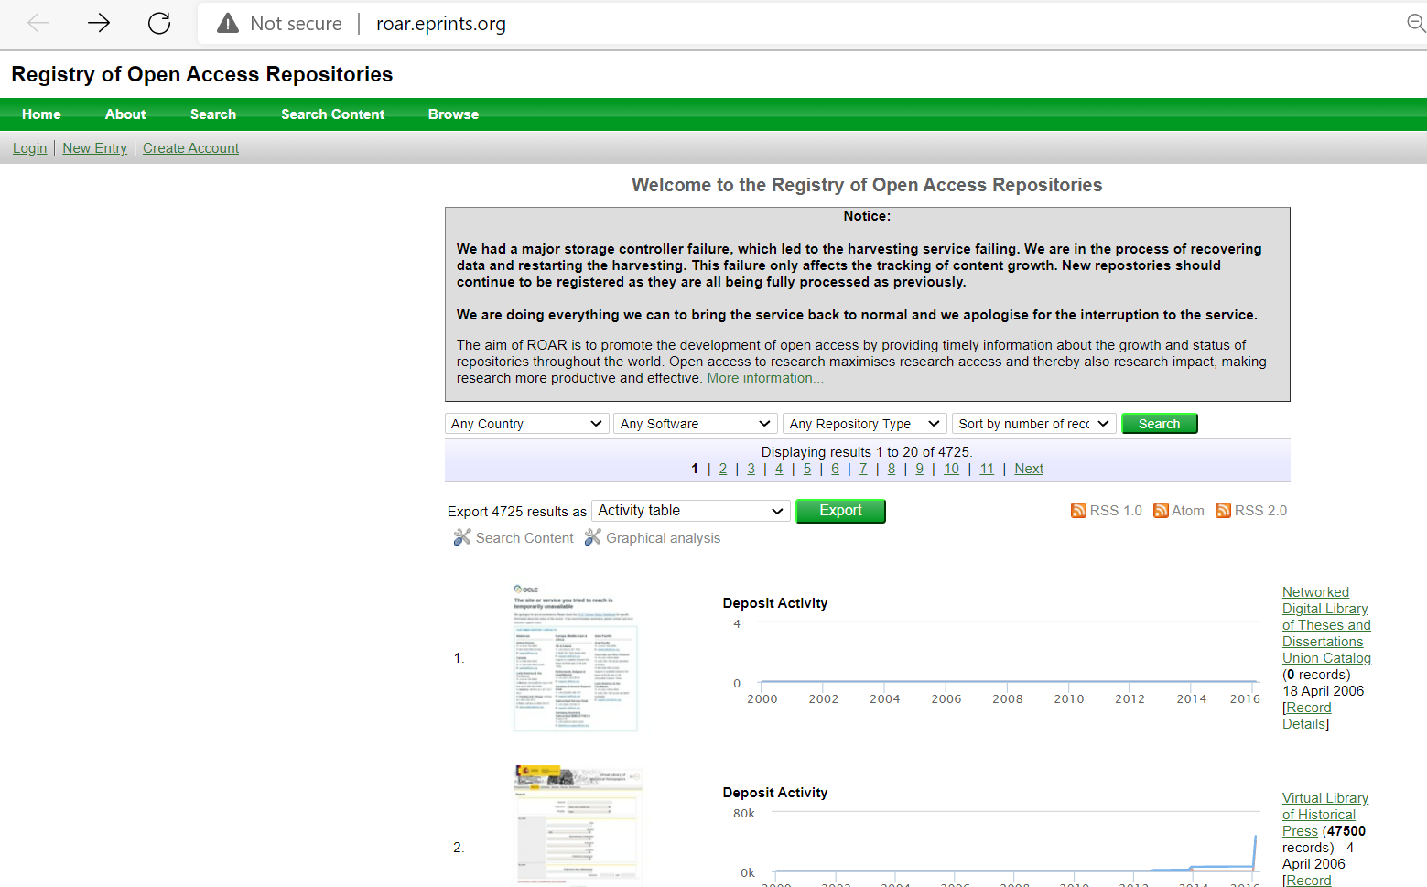
roar.eprints.org
Open Access Repositories Database

Slide 34
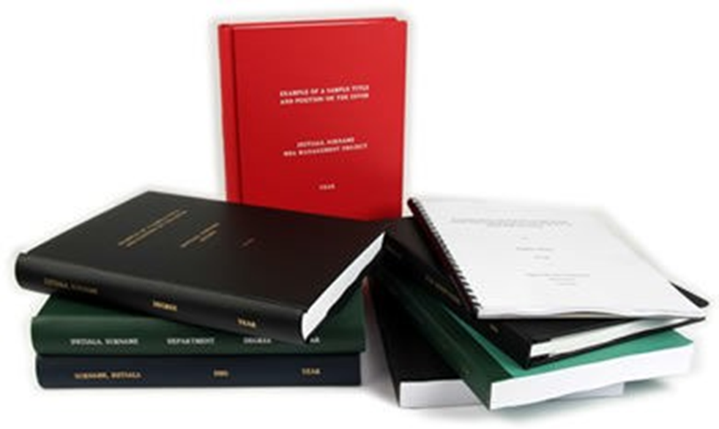
Electronic theses & Dissertations (e-theses & ETD)
http://search.ndltd.org/
https://oatd.org/
https://pqdtopen.proquest.com/search.html
biblioboard.com/opendissertations
This e-theses & ETD provide information previous studies conducted by others

Slide 35
Electronic theses & Dissertations (e-theses & ETD)

Slide 36
Open Access: the Challenges
From Collect to Connect
a shift in the role of the academic library from content owner to access point; providing access to information resources that are available for free

Slide 37
Open Access: the Challenges
Electronic Resources Librarians (ERL)
a shift in the role of the academic libraries from content owner to access point;
Managing access & use to information resources

Slide 38
Roles of Electronic Resources Librarians (ERL)
“An obvious and direct effect of the increasing availability of electronic resources in library collections was, and still is, the need to control and manage them. As simple as this task may sound, we, as librarians and library professionals, are still trying—more than a decade after the appearance of these electronically based resources—to find ways to administer these resources with the same comprehensive efficiency as we accomplished with print resources, all with new sets of tools and skills specifically tailored to the resources themselves and the new services these resources create.”—Marilyn Geller, Introduction to Library Technology Reports 42:2, “ERM: Staffing, Services, and Systems”

Slide 39
Roles
E-Resources Services & Consultations
E-Resources Provision
E-Resources Management
Collect and Connect

Slide 40
Trends of Open Access E-Resources

Slide 41
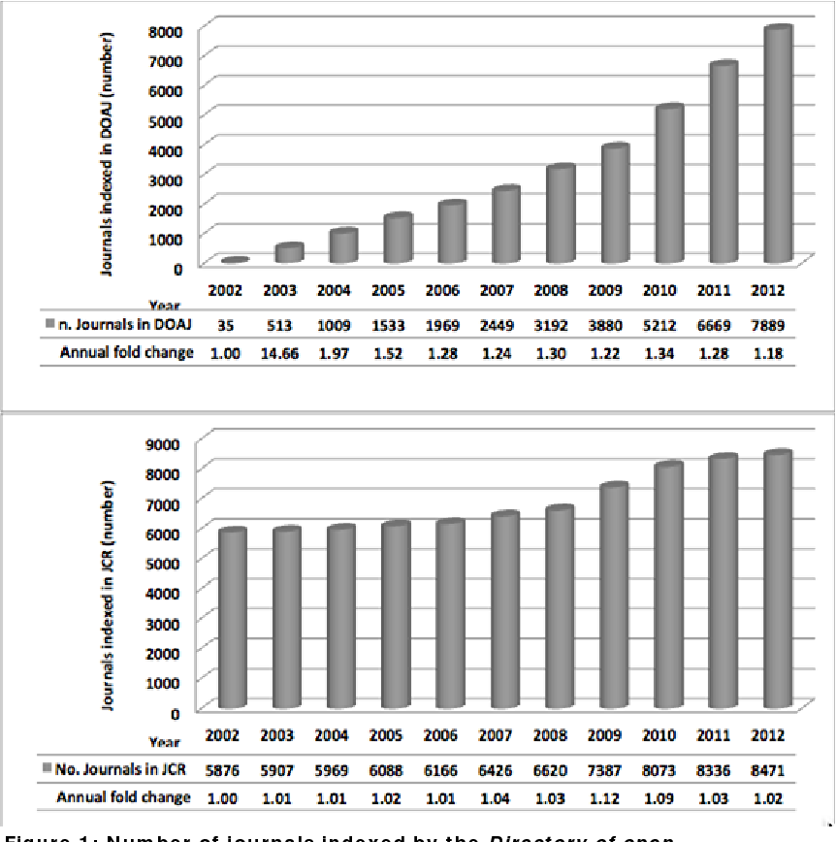
The Growth of Open Access

Slide 42
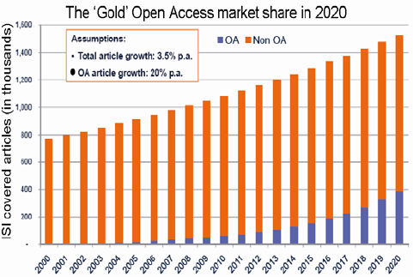

Slide 44
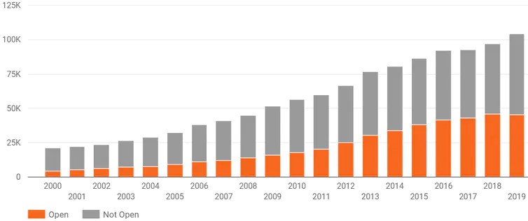
Open access in Australia

Slide 45
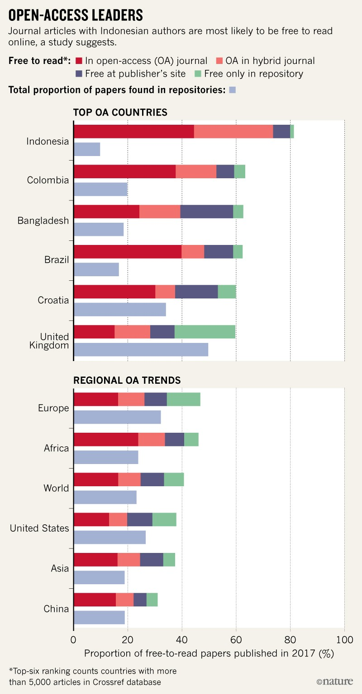
Open access Leaders in the World
Indonesia may be the world’s OA leader: the study found that 81% of ﻿20,000 journal articles published in 2017 with an Indonesia-affiliated author are available to read for free somewhere online, and 74% are published with open-access licences, meaning they could be legally redistributed (see ‘Open-access leaders’)
https://www.nature.com/articles/d41586-019-01536-5

Slide 46
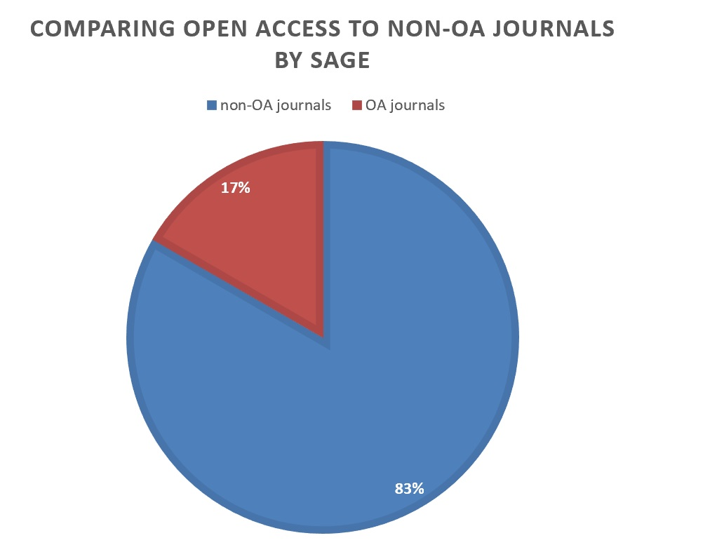
Open access in Commercial Publishers
Sage currently publishes 1,200 journals. Of these, 200 journals (about 17%) are fully open access. Compared to the last year’s data, there is a net increase of 41 open access journals (26% increase) published by Sage. Out of all open access journals, 185 journals (92 percent) have publication fees, 14 journals have no publication charges and 1 journal lacks the information whether it has processing fee or not.
Hamid Pashaei and Heather Morrison (2019)

Slide 47
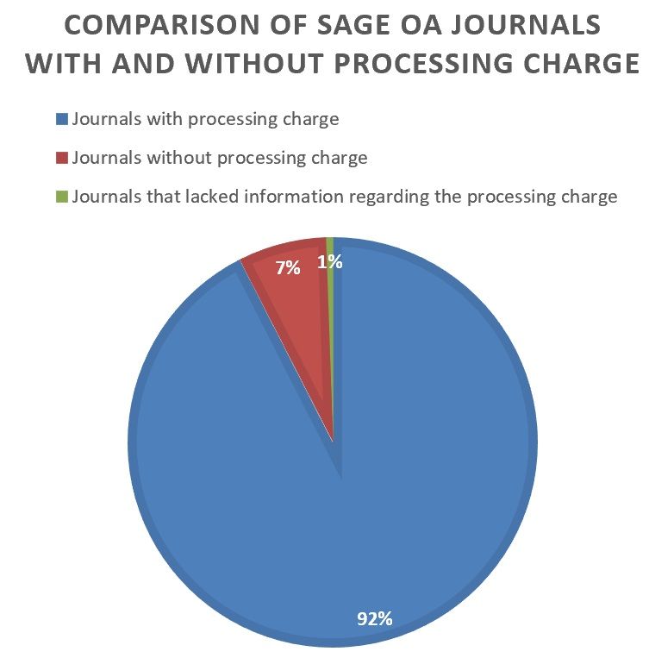
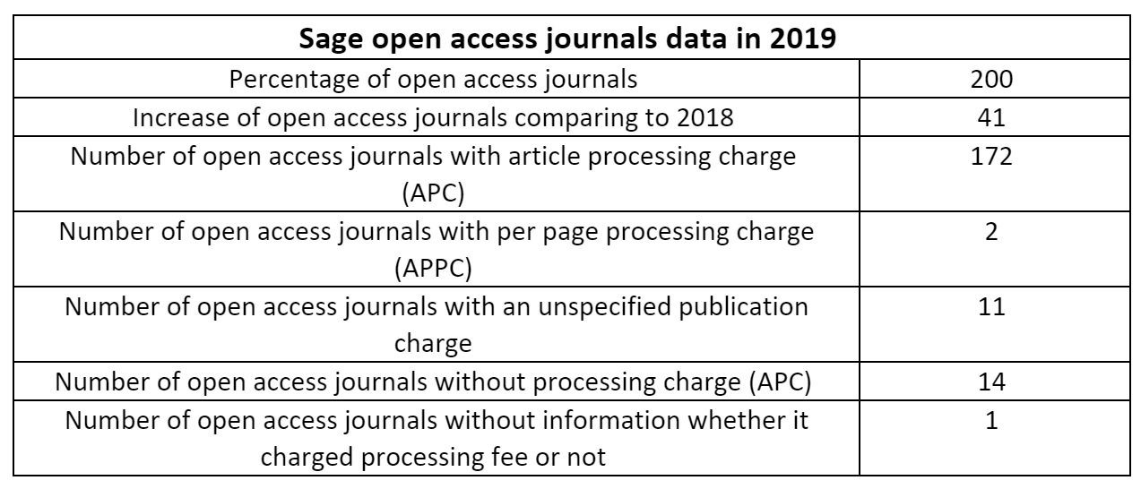
Out of the journals with processing charge, 172 journals charge ‘article processing fee’, 2 journals charge ‘per page processing fee’ and 11 articles lack the exact amount and way of processing fee.
Hamid Pashaei and Heather Morrison (2019)

Slide 48
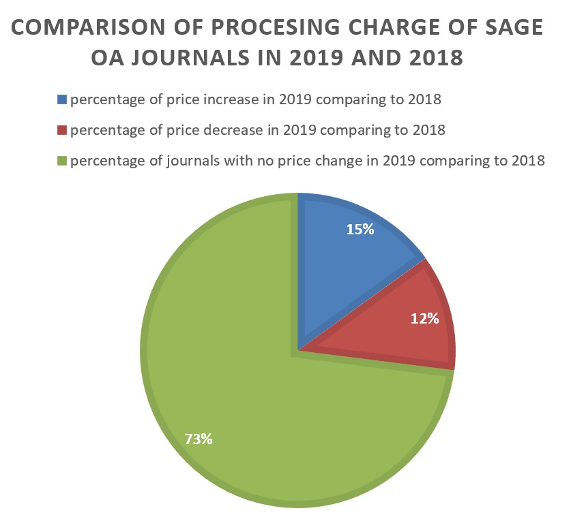
The average actual price for article processing fee in 2019 is $1475 that indicates a slight decrease comparing to the average price of $1513 in 2018

Slide 49
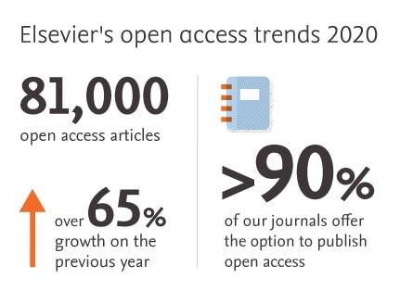
Over 90 percent of the journals we launch are open access. In 2020 we published over 81,000 gold open access articles, a growth of over 65% compared with the previous year.

Slide 50
The End …..
From ownership to access
From printed to electronic resources
Open Access Resources for sustainable academic library service
E-resources librarians

Slide 51
THANK YOU

