Slide 1
Better Identity Management in Improving Digital Resources Access
Presented at Seminar Nasional UPT Perpustakaan ISI – 21 October 2021
Mukhammad Andri Setiawan, PhD
Badan Sistem Informasi, Universitas Islam Indonesia
andri@uii.ac.id

Slide 2
It’s all because of pandemic
Network is extending from office/school to house
IT operational move from well known environment into uncharted territories
While at the same time, we need to maintain accessibility of all our digital resources

Slide 3
Question raised
How can we deliver digital resources while maintaining security aspects (confidentiality, integrity, accessibility)

Slide 4
Identity Access Management
By definition, it is a means to ensures only authorized people have access to technology resources
What make IAM different from a simple login page is it includes policies applied in organization
It authenticate and authorize people or groups of people, or software applications by providing user access rights and restrictions based on their identities

Slide 5
Why do we need one?
When organizations implemented IAM, their focus mainly on preventing cybersecurity breaches and attacks, also compliance to regulatory or governance mandates to protect sensitive data
While the main objective is to protect digital resources, but IAM (or IdM) can act not only as part of security that safeguard the digital resources but also to make a seamless access

Slide 6
Enabling Seamless Access
Single-Sign On is a mechanism to create a seamless experience for users when accessing catalogue of applications
A single experiences create happy users
Notes:
Removing local users – painful for developers, painful for end users
A system that allows users to access multiple web
applications at once, using just one set of
credentials

Slide 7
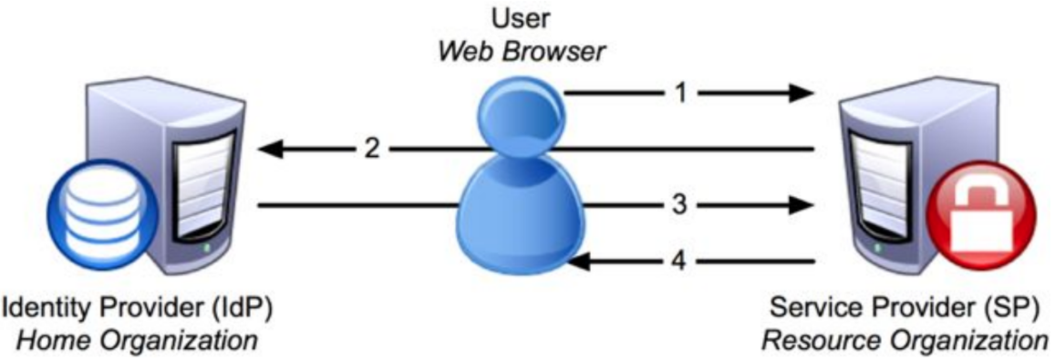
How does it work?
In principle, users do the login once, and then they can access all digital resources
The identity was obtained from IdP and sent to the SPs (the applications that consume authentication and attributes for authorization)

Slide 8
Advantages of using SSO
Only one place to logged-in, access logs are not scattered
Sessions can be brought to multiple applications, less in doing authentication process
Centralized database that contain information for authentication (and authorization) process to support compliance and administration
Simplified user access auditing

Slide 9
Library and Digital Resources
Library often subscribed to multiple digital resources e.g., e-books, journals, and many other digital resources
How can users access those resources?
Common method: access through IP address-based authentication. It’s prone to abuse and lack of authorization and accounting.
Other method: Library create/use application and setup its own login page, and often setup its own user database where admin must setup user database
Some potential issues
What if users no longer associated with organization?
What if they change roles?
What if organization need to differentiate access for different people with different role?

Slide 10
Identity Management
It is where users are created, and attributes are obtained
Track and manage changes to all entries and attributes defined
Basically, verify user identities

Slide 11
Identity Management
It help us manage our user management better
Provisioning and deprovisioning
Attributes assignment
Role assignments

Slide 12
Access Management
Evaluating the given attributes based on the implemented policies and creating access decision (allowed or not allowed) from them
Granting access for particular resources (control users’ access)
Notes:
This can be a tiered process, with access services that determine whether a user is authorized for any access on the network at all, and lower tiers of access that authenticate where the identity in question should be granted access to specific servers, drives, folders, files, and applications.
Remember that authentication is not the same thing as authorization. Although an identity (user) may be authorized to be on the corporate network and has an account in the directory, that does not automatically grant that identity the ability to access every application enterprise-wide. Authorization for any given application or resource will be determined by the identity’s attributes, such as which group(s) it belongs to, its level in the organization, or a specific role that was previously assigned.

Slide 13
Further with Identity Management

Slide 14
Rethinking of (digital) collaboration (for libraries)
How can we make the collaboration seamless?
When users are happy, they will access our resources more

Slide 15
Identity Federation
Notes:
Identity Federation
merupakan kumpulan
organisasi yang setuju untuk
beroperasi di bawah satu
kebijakan tertentu.

Slide 16
It’s not just merely an SSO
SSO is designed to authenticate a single credential across various system WITHIN one organization
Federated identity offer single access to several applications ACROSS various enterprises/organizations
Organization can use multiple services from multiple vendors with same user experiences
Inter organizations can collaborate more in sharing their resources
Notes:
The use of multiple services from multiple vendors
The demand to collaborate among government departments/units

Slide 17
Imagine this
A situation where one can access digital resources of other organization and authenticated against his/her own identity system
Home organization do not need to set up its own user database to allow visitor to access its resources
Case study:
National library can offer university students/lecturers to access their journal subscriptions rather than ask them to sign up with their own institutions SSO system
Scientists can more easily participate in global collaboration when the collaborations do not have to set up individual accounts

Slide 18
Some other scenarios of collaboration
Document Management
Storage and retrieval
Search
Categorize
Information Management
Calendar
Contacts
Discussions
Wikis
Collaboration
Access controls
Project workspaces
Data sharing
Project discussions

Slide 19
Benefits
Verified affiliation
Unique, verified information about user states
Accurate and up-to-date information
Automated verification of status
No need to support per service username and password
Reduced integration effort (do once, reuse many)
Reduced overhead for user support

Slide 20
Q&A

