Slide 1
MERAWAT GROWTH MIND SET
sumaryono.cendix@ugm.ac.id

Slide 2
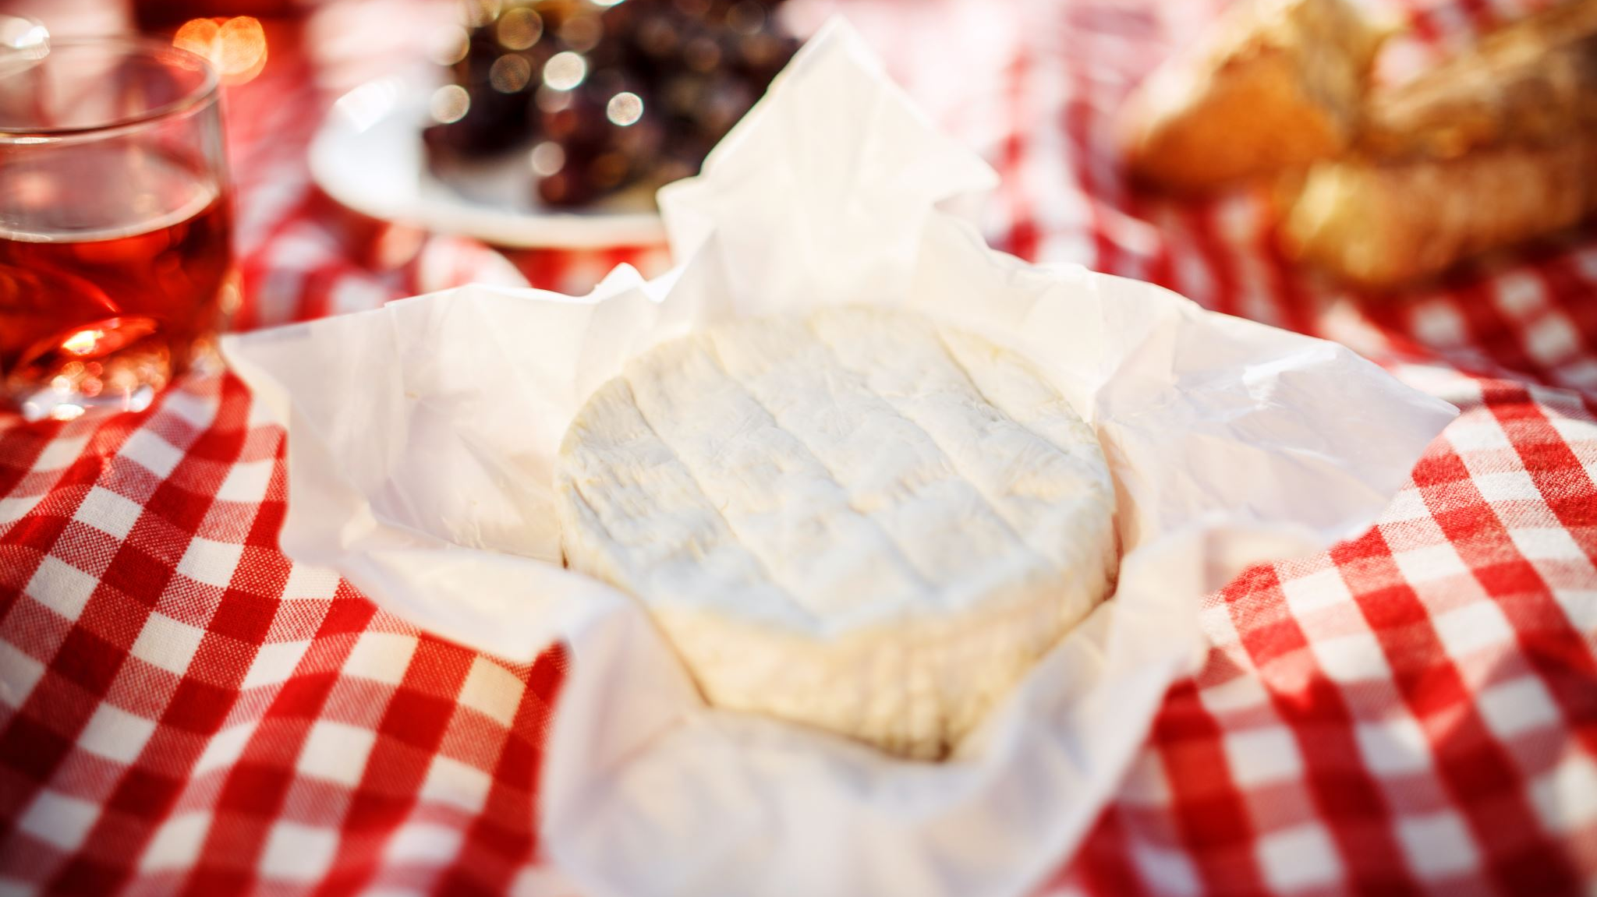
Haruskah kita berkembang?
WHO MOVE MY CHEESE

Slide 3
ILMU SANG KAMPIUM

Slide 4
Growth mindset …
Pola pikir yang meyakini – kemampuan dasar dapat dikembangkan melalui kerja keras dan dedikasi,
01
intelegensi dan bakat hanya merupakan modal awal saja.
02

Slide 5
Konsekuensi…
Seseorang dengan pola pikir ini meyakini bahwa
keterampilan dan keahlian merupakan sesuatu yang bisa dibangun dan dikembangkan.
sangat menghargai perbaikan proses.

Slide 6
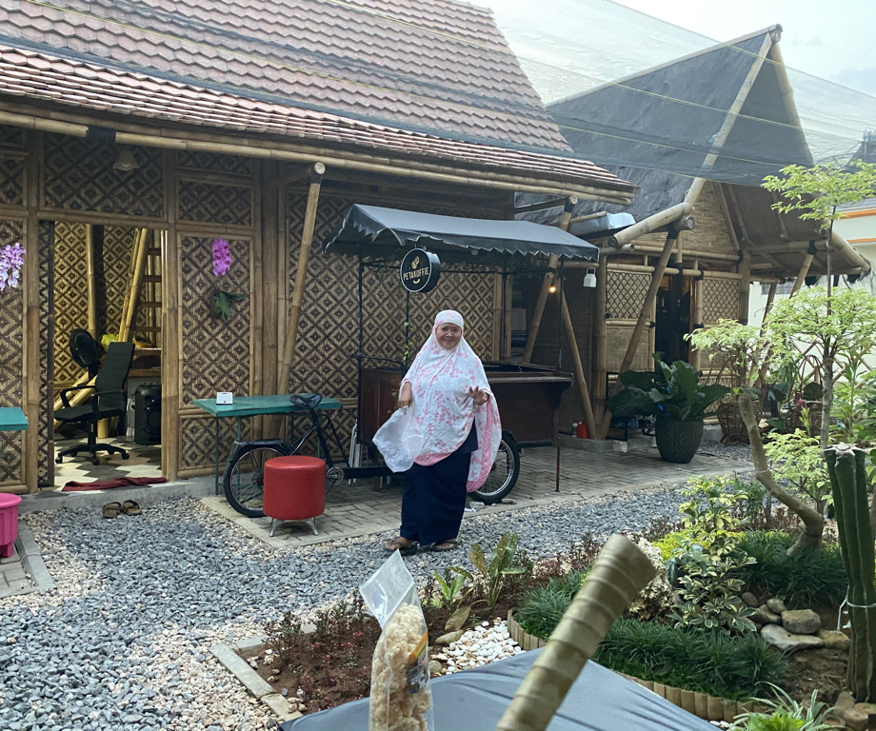
Growth mindset dalam karir
Makna Karir
Komitmen dan “engage”
Budaya Inovasi
Bangun sikap positif

Slide 7
Karir atau Kerja?

Slide 8
PILIHAN KARIR
Karir sbg Properti Organisasi
Karir = Perkembangan Posisi
Karir sbg Properti Individu
Karir = Pengembangan Kompetensi

Slide 9
INDIKATOR KARIR UNGGUL
Sukses sbg Investor
Bahagia
Bermakna

Slide 10
KUNCI PENTING POSITIVE WORK ATTITUDE
PRIDE & SKILL/KNOWLEDGE
PASSION & DIRECTION
BELIEF & ACTION

Slide 11
KUNCI PENTING POSITIVE WORK ATTITUDE
PRIDE & SKILL/KNOWLEDGE
PRIDE – SKILL/KNOWLEDGE → ARROGANCE (Arogan)
PRIDE + SKILL/KNOWLEDGE → THE BEST WORK EACH TIME (Kinerja Optimal sepanjang waktu)

Slide 12
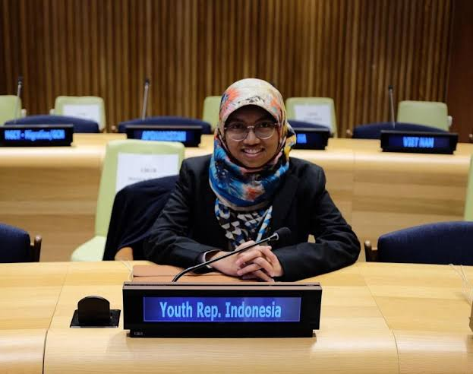
KUNCI PENTING POSITIVE WORK ATTITUDE
PASSION & DIRECTION
PASSION – DIRECTION → WASTE ENERGY (menghabiskan energi)
DIRECTION – PASSION → SUCCESS TAKE FAR LONGER (Bisa sukses, tetapi memerlukan waktu lama)
PASSION + DIRECTION →GOALS GALORE (Tujuan Berlimpah)

Slide 13
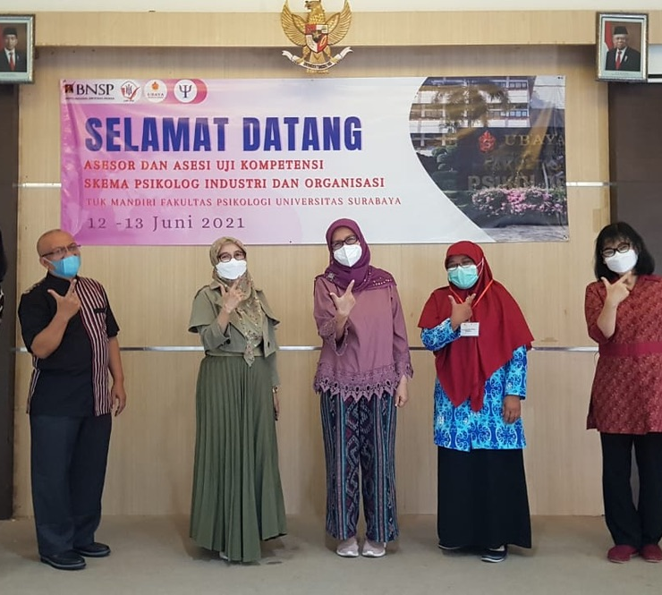
KUNCI PENTING POSITIVE WORK ATTITUDE
BELIEF & ACTION
Belief – Action → Fantasies (Fantasi atau Banyak Mimpi)
Action – Belief → Fool at work (bekerja tetapi tak berdasar)
Belief + Action → Dream Come True (Mimpi menjadi kenyataan)

Slide 14
Nilai Penting Sikap Positif
Sikap positif akan membuat individu menjadi lebih ...
Lentur (resiliensi)
Optimisme
Motivasi
Kreativitas
Cerdas secara emosi
Fokus

Slide 15
Keuntungan bagi Individu yang memiliki Sikap Positif
Less Stress
Empowerment
Happy peers
Job Security
Control

Slide 16
Make them Positive...
They will buy if I give them what they want.
They can afford it, if they want it.
They have high standards.
They want the best value for their money.
I can help them discover what they want.
If customers like me and my service, they’ll be happy to give referrals!
They will spend on things that are valuable to them.
Notes:
Look at how we took negative words and turned them into positive talk.
Words like “they will” instead of “they won’t” are more positive.
Turning phrases like “they’re a pain to work with” into “they have high standards” changes the way you look at and interact with “high maintenance people”.
Challenge the idea that some customers are “cheap” or “can’t afford a luxury cruise”. Instead, think of it this way. Most people work hard for their money. They’re careful about how they spend it. But most people are willing to spend on things that they VALUE.
Transition: “Let’s look at a few examples of this...”

Slide 17
Sikap Positif Staf Handal
“Safety Mind”
“Continuously Learning”
“Care and Serve”
“Helping people to Grow”

Slide 18
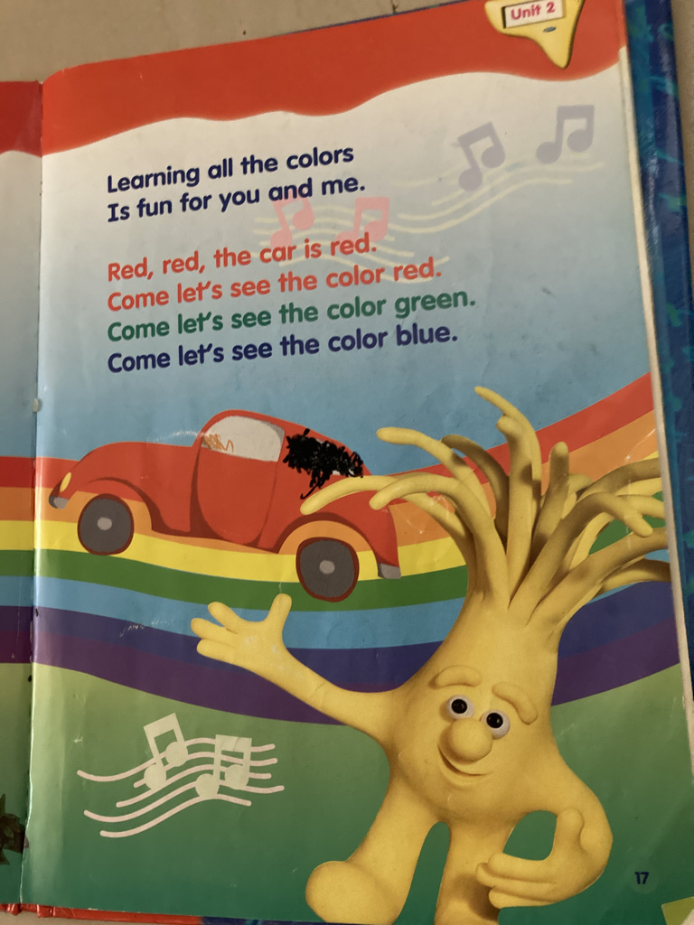
Konsep Perpustakaan Kekinian
Konsep Perpustakaan “Hype”
Menyediakan Working Space
Desain yg “Instagramable”
Dukungan “hot spot” cepat
Pemanfaatan AI, VR dan AR
Pemanfaatan Social Media

Slide 19
Kompetensi Pustakawan Kekinian
Cybarian – cyber librarian – pelayanan thd masyarakat virtual
Content Creator – kreativitas dalam penyajian Pustaka – pencipta informasi
Social Media Specialist – pemandu masyarakat dg literasi social media
Information Consultant – mendampingi masyarakat dalam pencarian informasi
Subject Specialist – berpengetahuan mendalam ttg sebuah disiplin ilmu

Slide 20
Matur nuwun

